Slide 1
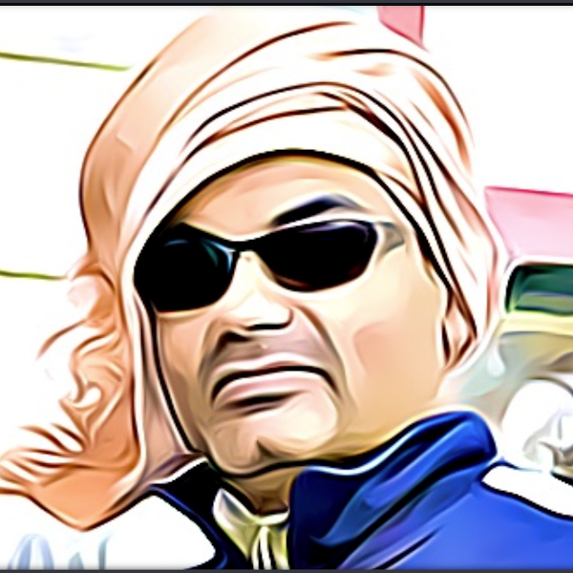
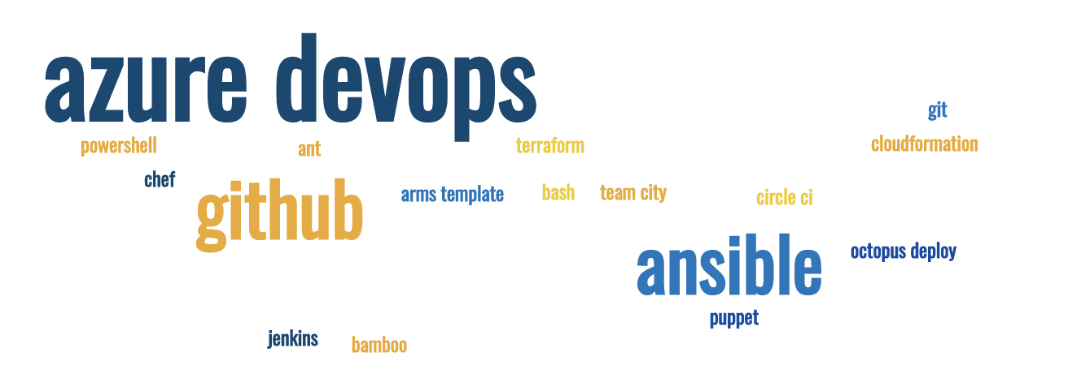
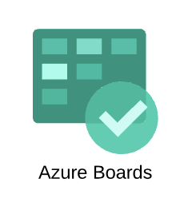



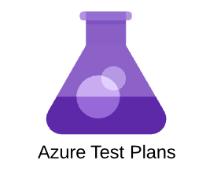
Azure DevOps part 2
Work Item management, Planning, Tracking
Sujit Singh

Slide 2
Agenda
Azure DevOps – Boards
What we will not cover today
What we are going to see today
Work items
Epics
Features
Stories
Tasks
Bugs
Area
Iteration
Boards

Slide 3
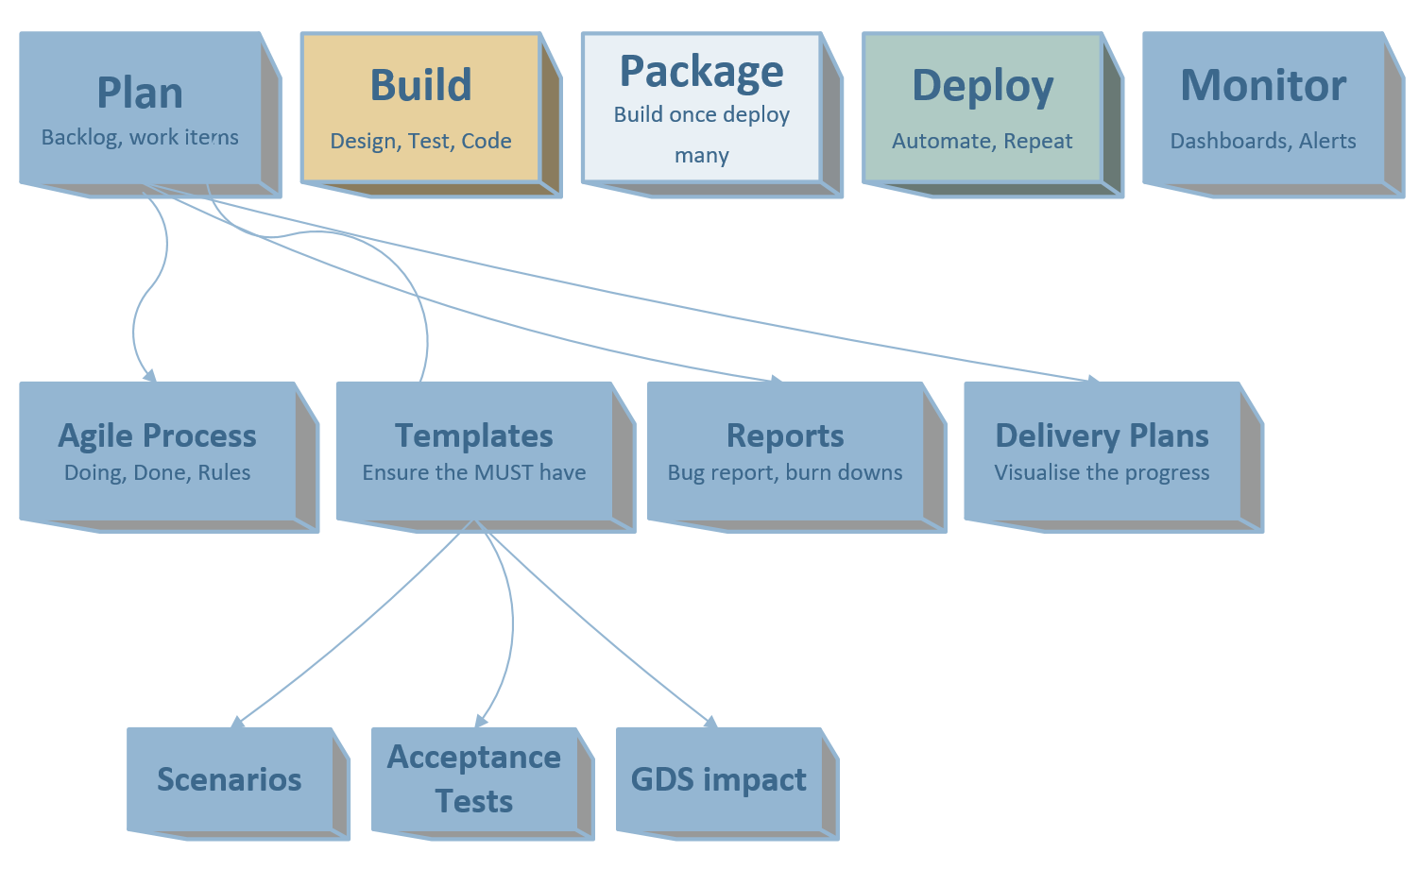
Azure DevOps – Boards (Plan)
Custom Rules

Slide 4
Not covering today
Processes
Customization
Rules
Agile, Scrum and Kanban

Slide 5
Azure Boards – Going through today
Work items
Area
Iteration
Boards
Some reports

Slide 6
Azure Boards – Work items
Epics
Features
Stories
Bugs
Tasks
Etc…

Slide 7



New
Create User story
Add initial high-level requirement
Ready
Clear Description updated
Acceptance Criteria
Approved
Team agrees and understand implementation requirement
Estimated
Active
Tasks created
Unit testing
Persona and context provided
Implementation done, tasks closed
Documentation done
Resolved
Closed
Verified
Stakeholders informed
Product Owner
Business Analyst
Product Owner
Engineers
Engineers
Product Owner
New stories can be created by other team members (delegated by PO if agreed)
Approval can be done by Scrum master if PO agrees
Story can be closed by Scrum master if PO agrees

Slide 8
Break
Comments

Slide 9
Example and Demo

